Slide 1


Slide 2
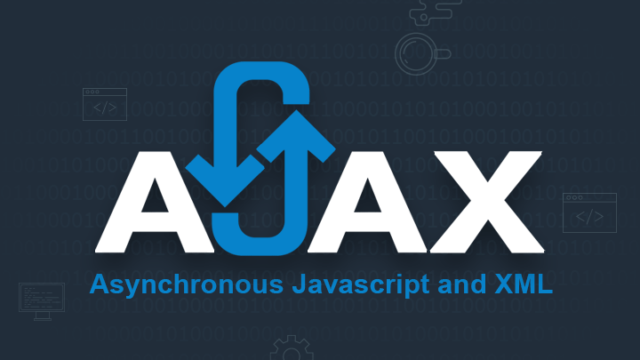

TODAY’S AGENDA
Introduction To AJAX
Advantages Of AJAX
Introduction To XMLHttpRequest class
Steps In AJAX Programming
Examples

Slide 3
PREREQUISITES
Familiarity with the following:
CLIENT SIDE
HTML
CSS
Java Script
DOM
SERVER SIDE
CLIENT SIDE
SERVER SIDE ( For JEE ) | SERVER SIDE ( For Django )
JSP | Views
Servlets | Templates
JDBC | Models

Slide 4
INTRODUCTION
AJAX stands for Asynchronous Java script And Xml
AJAX is not a new language , rather it is a new style of programming made popular by Google in 2007 and today it is the backbone of every dynamic web application.

Slide 5
NEED OF AJAX
When java script was released , it was able to interact with html but it had no way of communicating with the server.
Thus , the only way html page could communicate with a server side script like php or jsp was to make html form containing a submit button and generating get or post request .

Slide 6
NEED OF AJAX
Now , when the user clicks submit button a new page is generated by the server containing the desired results
But , sometimes on slow networks this could take time .
Moreover most of the time the new page has 90% elements same as the previous page only 10% of data gets changed.

Slide 7
SOLUTION
Ajax attempts to remedy this problem by letting our Java script communicate directly with the server, using a special Java script object XMLHttpRequest.
With this object, our Java script can get information from the server without having to load a new page!

Slide 8
STEPS OF AJAX PROGRAMMING
Following are the steps involved in AJAX :
Create Object for Ajax Request.
Specify a Handler.
Send the request.
Retrieve the data.

Slide 9
CREATING -OBJECT
The first step in AJAX based communication is to create an object of type XMLHttpRequest.
It is a built in class supported by every browser which has some very important properties/methods for generating Ajax request and receiving response.

Slide 10
CODE
<script >
let ajaxreq=new XMLHttpRequest();
.
.
.
.
</script>

Slide 11
SPECIFY HANDLER
When we use AJAX we can’t be sure when the response will come back .
So before we generate the request we must first specify a function to be called when the response comes back from the server.
This function is called “RESPONSE HANDLER”.

Slide 12
SPECIFY HANDLER
Tasks of RESPONSE HANDLER :
Receive the information sent by server.
Extract the data.
Display the result at appropriate place.

Slide 13
SPECIFY HANDLER
Syntax :
ajaxreq.onreadystatechange=<func name>;
The onreadystatechange is the property of the AJAX object which receives a function name as it’s value and every time the readyState property of the AJAX object changes then the function gets executed

Slide 14
THE readyState PROPERTY
The process of communicating with the server begins with sending of the request and finishes when the response comes back .
In between there are many stages involved and these stages are represented using the readyState property

Slide 15
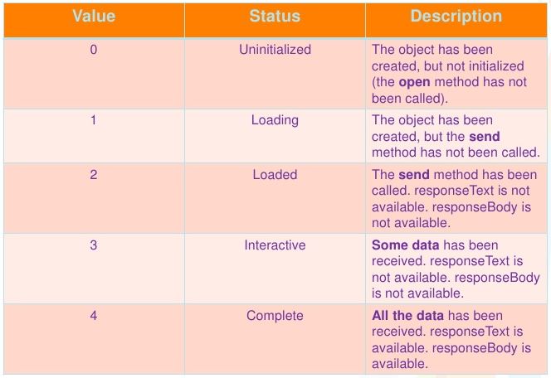
readyState VALUES

Slide 16
THE readyState PROPERTY
Every time the readyState changes the function indicated by the onreadystatechange property gets called.
There are five steps , so function will be called four times
But we are interested in the completed state because the data is only available after the state is 4

Slide 17
THE Handler FUNCTION
function< function name>()
{
if (ajaxreq.readyState==4)
{
// do something with the data
}
}

Slide 18
SEND THE INFORMATION
After we have specified handler we can send request to the server.
This involves 2 steps:
Opening the connection .
Sending the request.

Slide 19
OPENING THE CONNECTION
Before sending the request we need to establish a connection to the server which is done by calling the method open( ) of the XMLHttpRequest object.
It has the following prototype:
open(method , url , isasynchronous)

Slide 20
OPENING THE CONNECTION
method : The type of method being requested GET or POST
url : URL of the page to request.
isasynchronous: a boolean value indicating whether request will be asynchronous (true) or synchronous(false).

Slide 21
OPENING THE CONNECTION
Sample Call 1 ( For Java Backend ):
ajaxreq.open(“GET” ,”getdetails.jsp”,true);
Sample Call 2(For Django Backend):
ajaxreq.open(“GET” ,”getdetails?roll=10”,true);

Slide 22
OPENING THE CONNECTION
Sample Call 1(For Django Backend ):
ajaxreq.open(“GET” ,”getdetails”,true);
Sample Call 2(For Django Backend ):
ajaxreq.open(“GET” ,”getdetails?roll=15”,true);

Slide 23
SENDING THE REQUEST
Once we have established the connection to the server we can send request to the server.
To do this we use another method provided by the XMLHttpRequest object called send() which has the following form:
send(parameter);
If we have used “GET” as argument in open() then we pass null as parameter.

Slide 24
SENDING THE REQUEST
Otherwise if we have used “POST” as argument in open() then we have to do 2 things:
Call the setRequestHeader() method passing it “content-type”, “ application/x-www-form-urlencoded” as argument. This tells the server that the data is being sent as a part of request body.
Call send () by passing required parameter as argument.

Slide 25
SAMPLE
So the complete steps will become :
For Java Backend
ajaxreq.open(“POST” , “getdetails.jsp” , true);
ajaxreq.setRequestHeader(“content-type” , “application/x-www- form-urlencoded”);
ajaxreq.send(“roll=10”):
For Django Backend
ajaxreq.open(“POST” , “getdetails” , true);
ajaxreq.setRequestHeader(“content-type” , “application/x-www- form-urlencoded”);
ajaxreq.send(“roll=10”):

Slide 26
RETRIEVE THE DATA
The last step is to receive the response sent by the server .
This done by accessing the property responseText of XMLHttpRequest object

Slide 27
SYNTAX
function <function name> ()
{
If(ajaxreq.readystate==4)
{
var x= ajaxreq.responseText;
//further processing
}
}

Slide 28
EXERCISE 1
Write an AJAX based application to get the date from server and display it on the page.

Slide 29
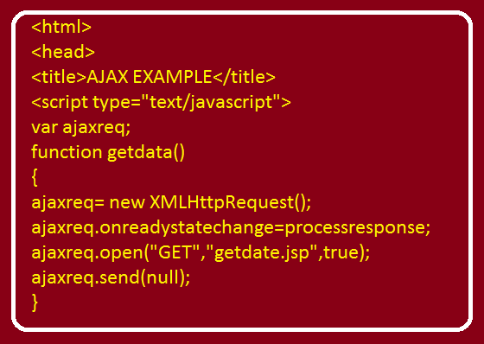
SOLUTION (The html Page)

Slide 30
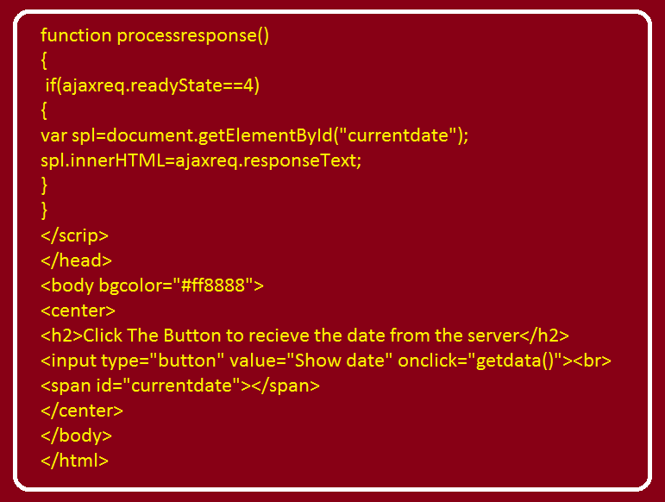
SOLUTION (The html Page)

Slide 31
SOLUTION (The jsp Page)
<%@ page import="java.util.*,java.text.*" %>
<%
Date today=new Date();
SimpleDateFormat sdf=new SimpleDateFormat("dd-MMM-yyyy");
String str=sdf.format(today);
%>
<h3>Date at server is <%= str %></h3>

Slide 32
EXERCISE 2
Write an AJAX based application to accept two nos from the user , send them to the server, receive their sum from the server and display the result on the page.

Slide 33
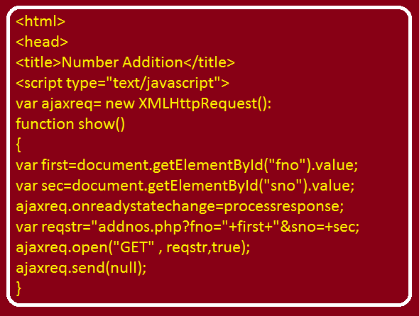
SOLUTION (The html Page)

Slide 34
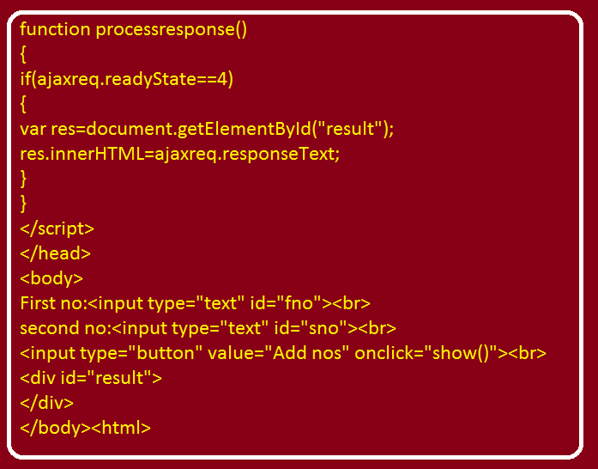
SOLUTION (The html Page)

Slide 35
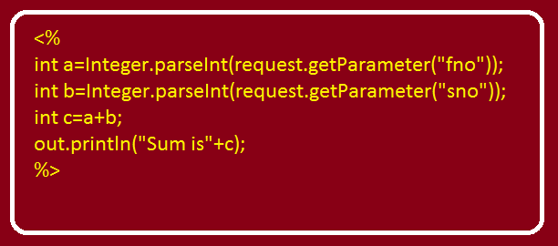
SOLUTION (The jsp Page)

Slide 36
EXERCISE 3
Write an AJAX based application to accept an Employee Name from the user , send it to the server, receive his/her salary from the server and display the result on the page.
Assume names of all the Employees and their salaries are stored in the database in a table called EMP with columns as ENAME and SAL.

Slide 37
EXERCISE 4
Write an AJAX based application to accept an UserName from the user , and verify whether this username is available or not. If it is available then show the message “username available” in green and if it is not available then show the message “username not available” in red.
Assume names of all the users and their passwords are stored in the database in a table called ALLUSERS with columns as USERNAME and PASSWORD

Slide 38
EXERCISE 5
Write an AJAX based application to accept an Employee Name from the user , send it to the server, receive details (EMPNO,ENAME,SAL,JOB)from the server and display the result on the page.
Assume names of all the Employees and their salaries are stored in the database in a table called EMP with columns as EMPNO,ENAME,SAL and JOB.

Slide 39
EXERCISE 6
Write an AJAX based application to allow the user to select an Employee Number from a drop down list , send it to the server, receive his/her ENAME,DEPTNO,SALARY and JOB from the server and display the result on the page. Make sure the Employee Numbers shown are also picked from the database.
Assume names of all the Employees and their salaries are stored in the database in a table called EMP with columns as ENAME and SAL.

Slide 40
EXERCISE 7
Modify the EXERCISE 5 , so that even if the user presses ENTER key after inputting ENAME then also record should be displayed.

Slide 41
EXERCISE 8
Develop an AJAX based REGISTRATION APPLICATION having following behaviour:
The registration page should have following fields:
(i) User ID (It should be your email id).
(ii) Password
(iii) UserName
If registration is successful then it should
welcome the user (Make sure registration only happens if the User ID provided is available).
If User ID is not available it should ask user to register
again with different user ID.

Slide 42
EXERCISE 9
Develop an AJAX based LOGIN APPLICATION having following behaviour:
1. It should perform validation
2. If validation is successful then login credentials should be passed to server
3. At the server end login credentials should be verified with the database and accordingly the response should be generated
Finally this response should be generated on the page via AJAX.

